Slide 1
Redux Saga
Redux Saga concepts
Example application
Understanding the example application

Slide 2
Section 1: Redux Saga Concepts
Overview
A saga is a generator function
Calling a generator
Using a generator in a loop

Slide 3
Overview of Redux Saga
Redux Saga is a library to help you run "side effects" in your React application, typically asynchronously
E.g. call a REST service
E.g. interact with local storage
E.g. perform a complex calculation
Reasons for using Redux Saga to do this:
Easier to coordinate asynchronous tasks
Integrates very smoothly with Redux Store
3

Slide 4
A Saga is a Generator Function
A saga is a generator function (an ES6 language feature)
The function signature has a *
Inside the function, use the yield keyword to yield control back to the client (optionally supplying a value)
function * ducklingGenerator() {
console.log("\nGenerating duckling #1")
yield "Huey"
console.log("\nGenerating duckling #2")
yield "Luey"
console.log("\nGenerating duckling #3")
yield "Duey"
}
4

Slide 5
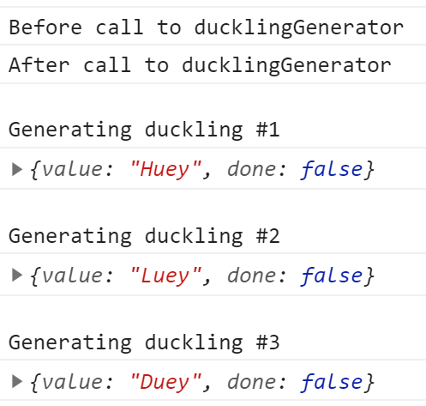
Calling a Generator
Here's some client code, which shows how to use the generator function to get a series of values:
console.log("Before call to ducklingGenerator")
let genObj = ducklingGenerator()
console.log("After call to ducklingGenerator")
let res1 = genObj.next()
console.log(res1)
let res2 = genObj.next()
console.log(res2)
let res3 = genObj.next()
console.log(res3)
5

Slide 6
Using a Generator in a Loop
You can use a generator with a for-of loop
Each iteration returns the next yielded value
When the generator is "done", the loop terminates
for (let res of ducklingGenerator())
console.log(res)
6

Slide 7
Section 2: Example Application
Overview
Using sagas to perform a simple async task
Using sagas to call a REST service

Slide 8
Overview
We've implemented a React app to demonstrate sagas:
Go to the demo-app folder
Run and
You'll also need to run a Node.js REST server app:
Go to the server folder:
Run and
npm install
npm start
npm install
npm start
8

Slide 9
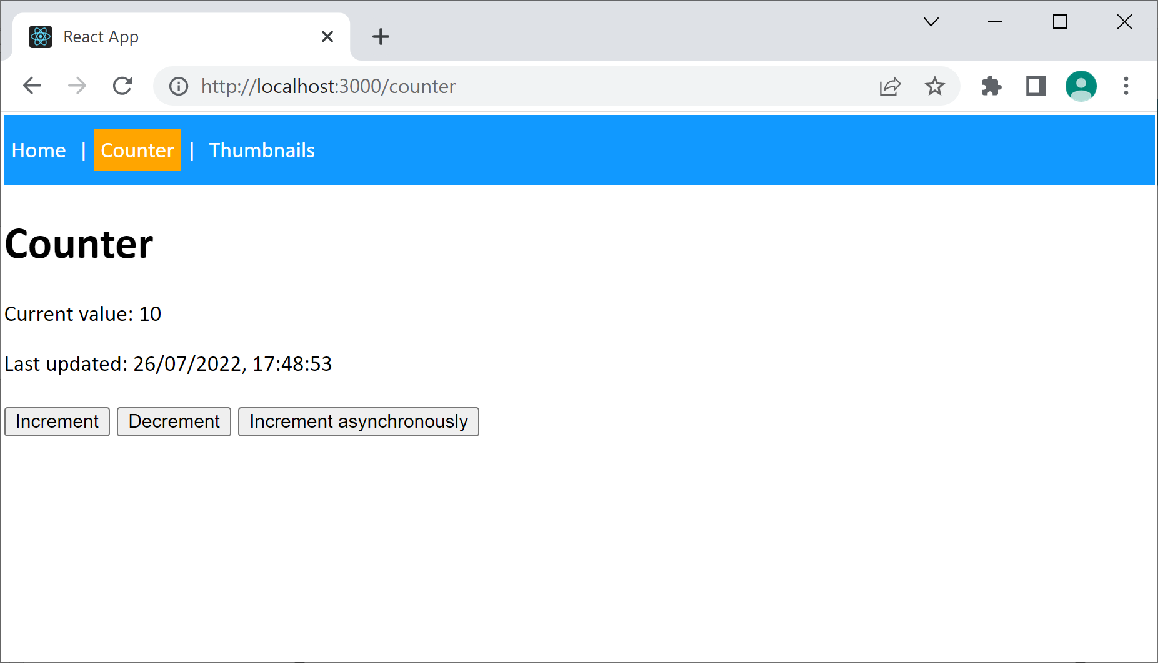
Using Sagas to Perform a Simple Async Task
In the React demo app, click the Counter menu item
Then click the Increment asynchronously button
The app uses sagas to update a counter asynchronously
9

Slide 10
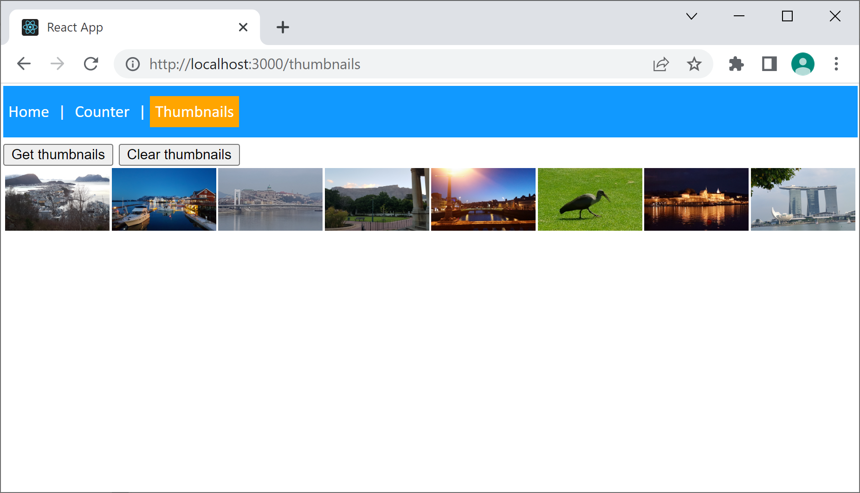
Using Sagas to Call a REST Service
In the React demo app, click the Thumbnails menu item
Then click the Get thumbnails button
The app uses sagas to call a REST service asynchronously
10

Slide 11
Section 3: Understanding the Example Application
Dependencies for Redux Saga
Integrating Saga middleware into Redux
Implementing the root saga
Implementing watcher sagas
Implementing worker sagas
Putting it all together - counter component
Putting it all together - thumbnails component

Slide 12
Dependencies for Redux Saga
To use Redux Saga in a React app, add the following dependencies in your package.json file
The app also has the following dependencies…
React Redux (required by Redux Saga)
Redux Toolkit (to simplify React Redux code)
React Router (to make the app look pretty ☺)
{
"dependencies": {
"redux-saga": "^1.1.3",
"@types/redux-saga": "^0.10.5",
…
},
…
}
package.json
12

Slide 13
Integrating Saga Middleware into Redux (1 of 2)
When a React app starts, you must add Saga middleware into the Redux Store
Enables sagas to handle actions from Redux
Enables sagas to dispatch new actions to Redux
Redux Store
Saga Middleware
Sagas can handle actions from Redux
Sagas can dispatch new actions to Redux
13

Slide 14
Integrating Saga Middleware into Redux (2 of 2)
Here's how to add Saga middleware into the Redux Store:
import createSagaMiddleware from 'redux-saga'
import myRootSaga from './sagas'
…
const sagaMiddleware = createSagaMiddleware()
const store = configureStore({
reducer: { … },
middleware: (getDefaultMiddleware) =>
getDefaultMiddleware().concat(sagaMiddleware)
})
sagaMiddleware.run(myRootSaga)
index.tsx
Redux Store
myRootSaga
(see next slide)
Saga Middleware
14

Slide 15
Implementing the Root Saga
On the previous slide, we ran the root saga:
What is the root saga?
It's a saga (i.e. a generator function)
It runs all watcher sagas, which watch for Redux actions
index.tsx
sagaMiddleware.run(myRootSaga)
import {all} from 'redux-saga/effects'
…
export default function * myRootSaga() {
yield all([
watchIncrementAsync(),
watchGetThumbnailUrlsAsync()
])
}
sagas.ts
15

Slide 16
Implementing Watcher Sagas
What is a watcher saga?
It's a saga that takes an action from Redux Store, and passes it on to a worker saga to process it
import {takeEvery} from 'redux-saga/effects'
…
function * watchIncrementAsync() {
yield takeEvery('incrementAsync', doIncrementAsync)
}
sagas.ts
16

Slide 17
Implementing Worker Sagas
What is a worker saga?
It's a saga that performs an asynchronous operation
Typically sends an action back to Redux Store when done
Note:
delay() returns a Promise, which we yield to Saga m/w
Saga m/w calls us back when the Promise is resolved
import {put} from 'redux-saga/effects'
…
function * doIncrementAsync() {
for (let i = 0; i < 10; i++) {
yield delay(1000) // Delay for 1 second.
yield put(counterSlice.actions.increment()) // Then send action to Redux.
}
}
sagas.ts
17

Slide 18
Putting it all Together - Counter Component
counterSlice.ts
What state does the slice manage?
What actions does the slice reducer handle?
Counter.tsx
How does the component display state?
What actions does the component dispatch?
sagas.ts
What counter actions are handled by sagas, and how?
18

Slide 19
Putting it all Together - Thumbnails Component
thumbnailsSlice.ts
What state does the slice manage?
What actions does the slice reducer handle?
Thumbnails.tsx
How does the component display state?
What actions does the component dispatch?
sagas.ts
What thumbnails actions are handled by sagas, and how?
19

Slide 20
Summary
Redux Saga concepts
Example application
Understanding the example application

